Slide 1
Section 6.3
Exponential Functions
Copyright © 2012 Pearson Education, Inc. Publishing as Prentice Hall.

Slide 2
Copyright © 2012 Pearson Education, Inc. Publishing as Prentice Hall.

Slide 3


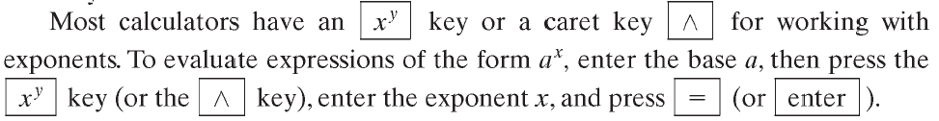
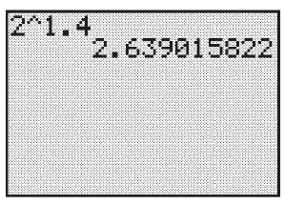

Copyright © 2012 Pearson Education, Inc. Publishing as Prentice Hall.

Slide 4

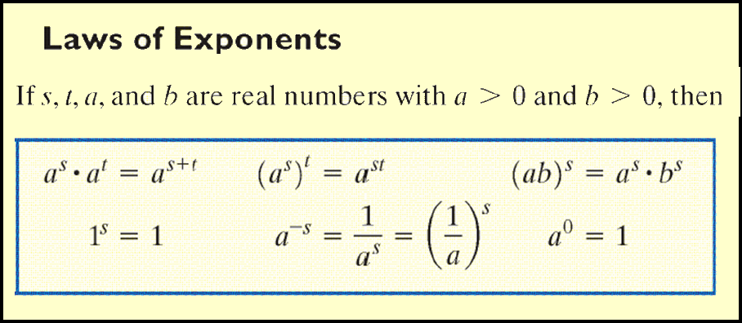
Copyright © 2012 Pearson Education, Inc. Publishing as Prentice Hall.

Slide 5
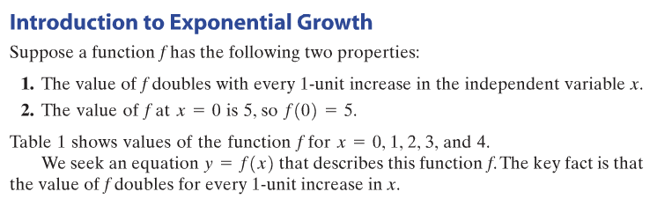
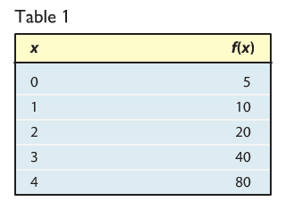
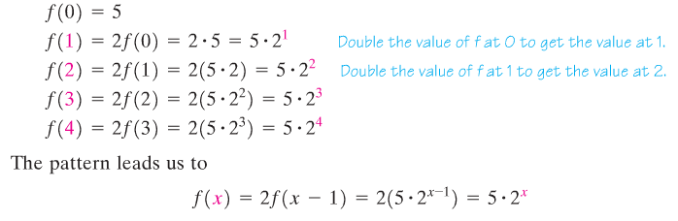
Copyright © 2012 Pearson Education, Inc. Publishing as Prentice Hall.

Slide 6

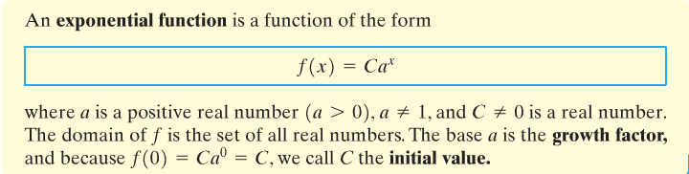
Copyright © 2012 Pearson Education, Inc. Publishing as Prentice Hall.

Slide 7
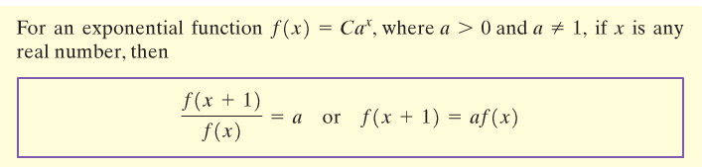
Copyright © 2012 Pearson Education, Inc. Publishing as Prentice Hall.

Slide 8
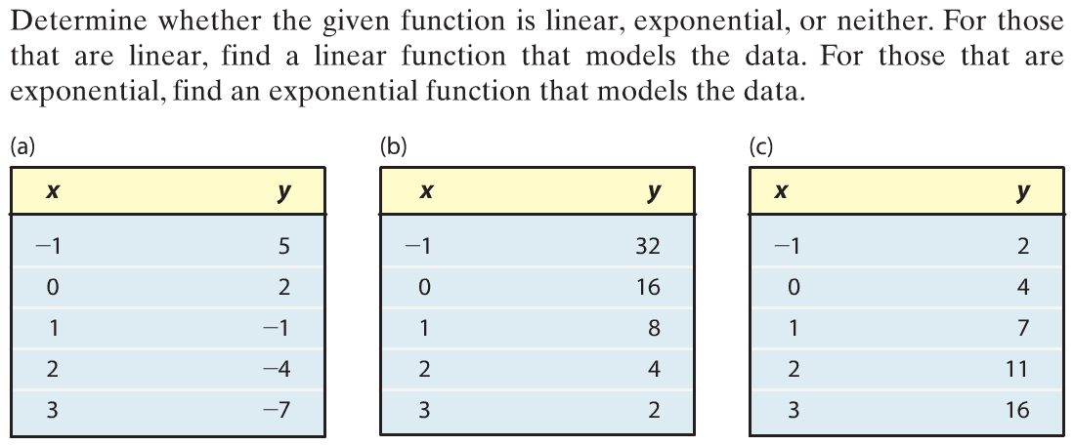
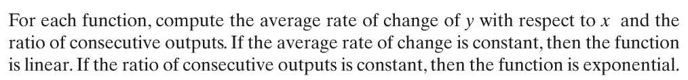
Copyright © 2012 Pearson Education, Inc. Publishing as Prentice Hall.

Slide 9
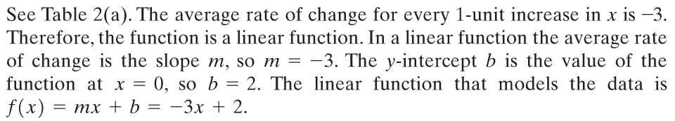
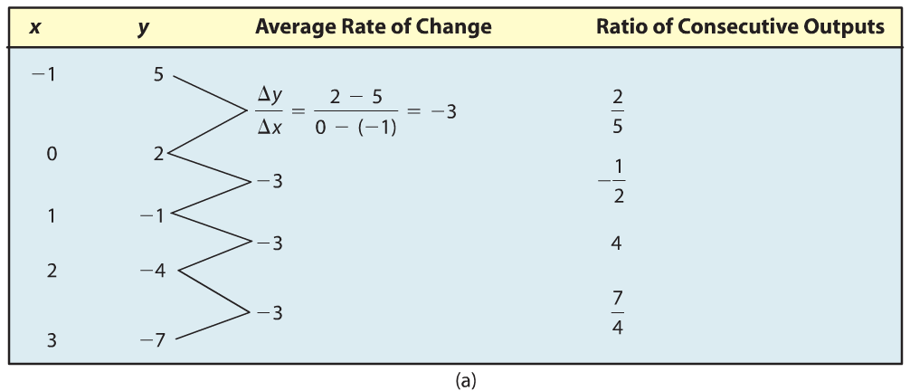
Copyright © 2012 Pearson Education, Inc. Publishing as Prentice Hall.

Slide 10
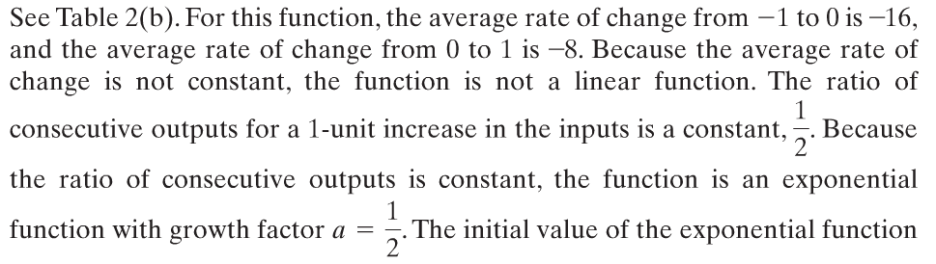
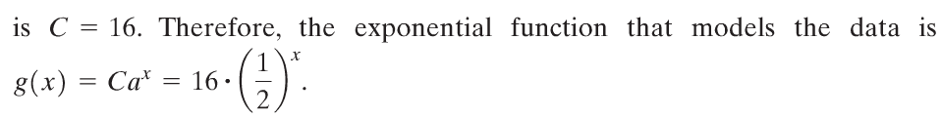
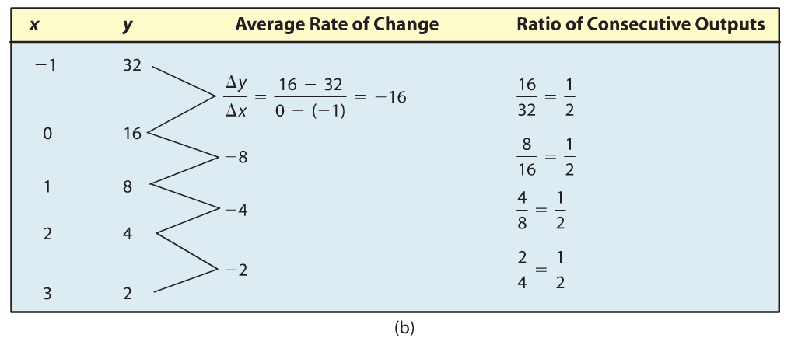
Copyright © 2012 Pearson Education, Inc. Publishing as Prentice Hall.

Slide 11
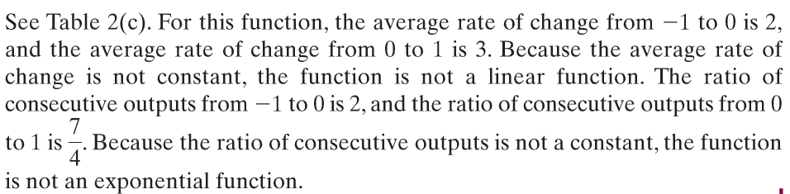
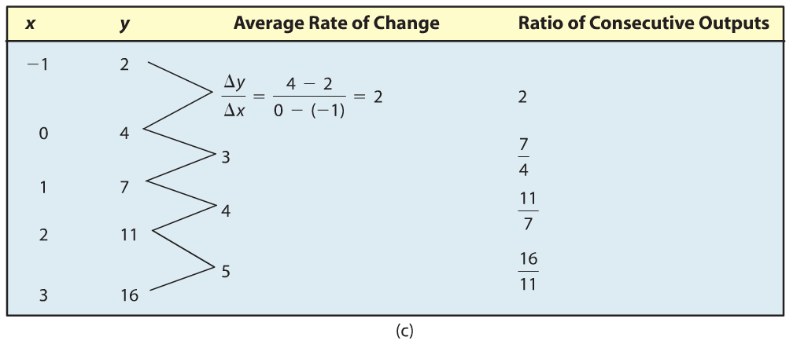
Copyright © 2012 Pearson Education, Inc. Publishing as Prentice Hall.

Slide 12

Copyright © 2012 Pearson Education, Inc. Publishing as Prentice Hall.

Slide 13
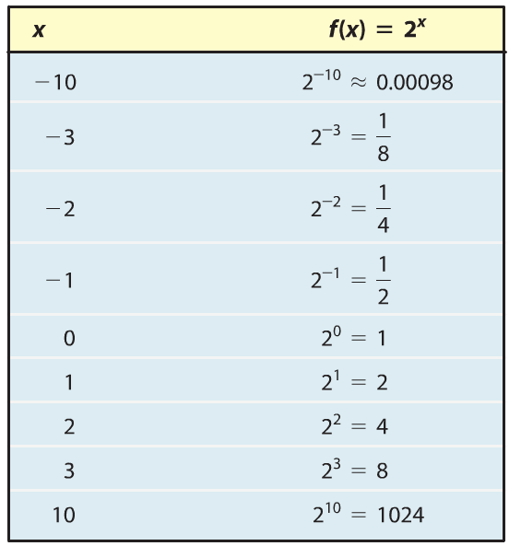
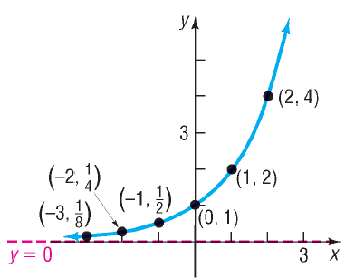
Copyright © 2012 Pearson Education, Inc. Publishing as Prentice Hall.

Slide 14
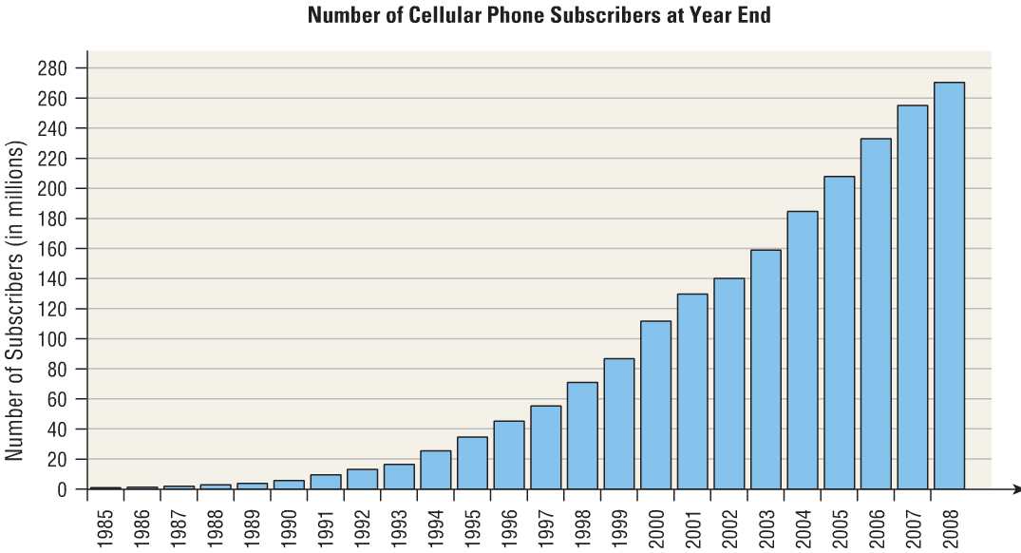
Copyright © 2012 Pearson Education, Inc. Publishing as Prentice Hall.

Slide 15
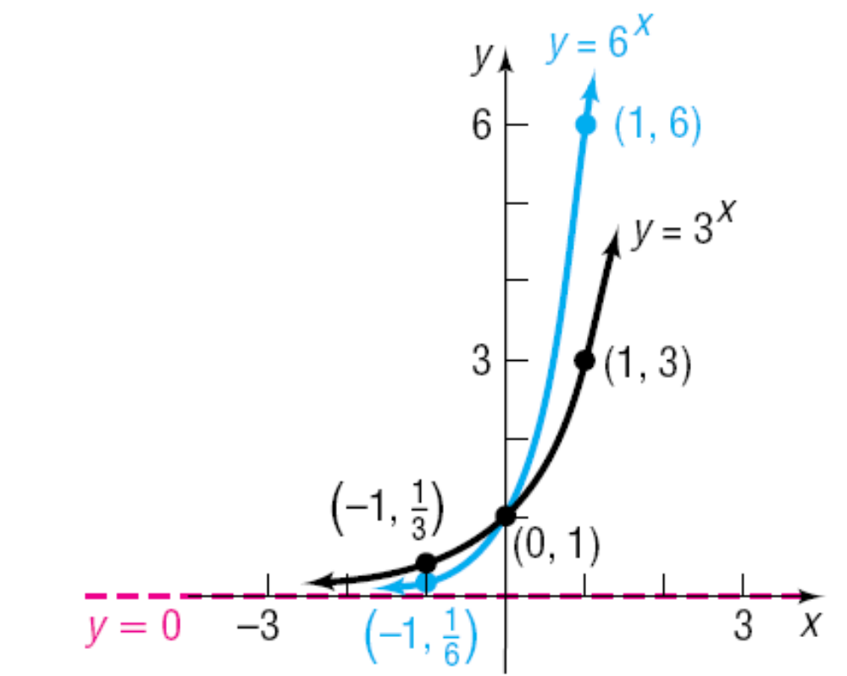
Copyright © 2012 Pearson Education, Inc. Publishing as Prentice Hall.

Slide 16


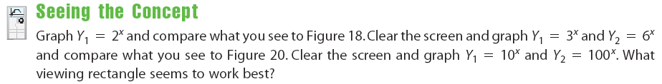




Copyright © 2012 Pearson Education, Inc. Publishing as Prentice Hall.

Slide 17
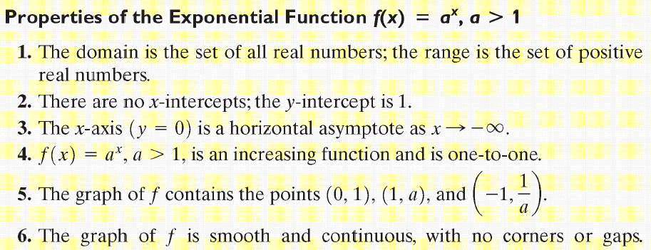
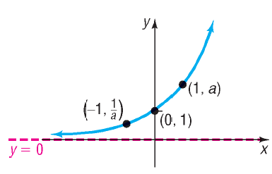

Copyright © 2012 Pearson Education, Inc. Publishing as Prentice Hall.

Slide 18

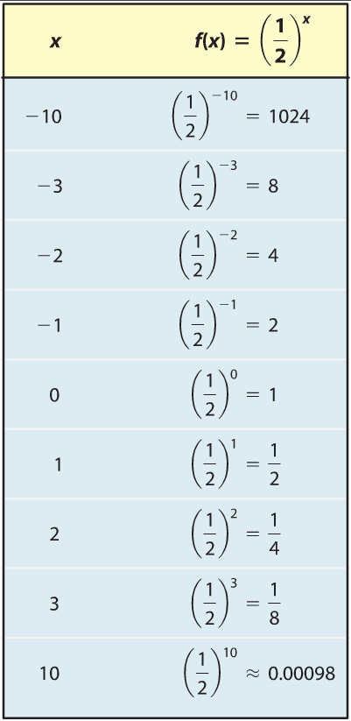
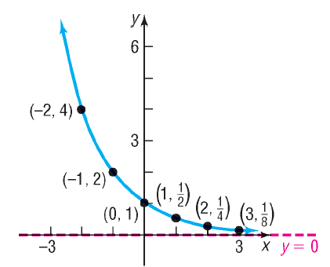
Copyright © 2012 Pearson Education, Inc. Publishing as Prentice Hall.

Slide 19
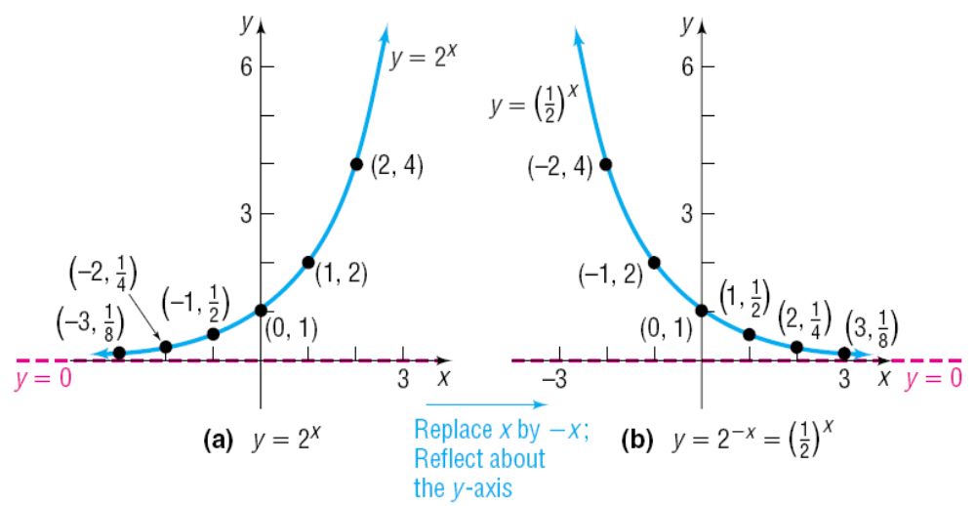
Copyright © 2012 Pearson Education, Inc. Publishing as Prentice Hall.

Slide 20
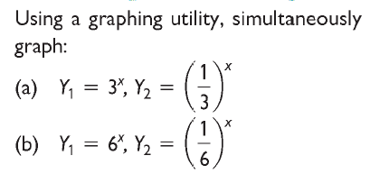
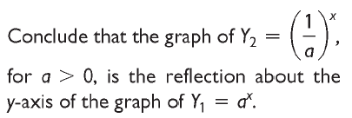
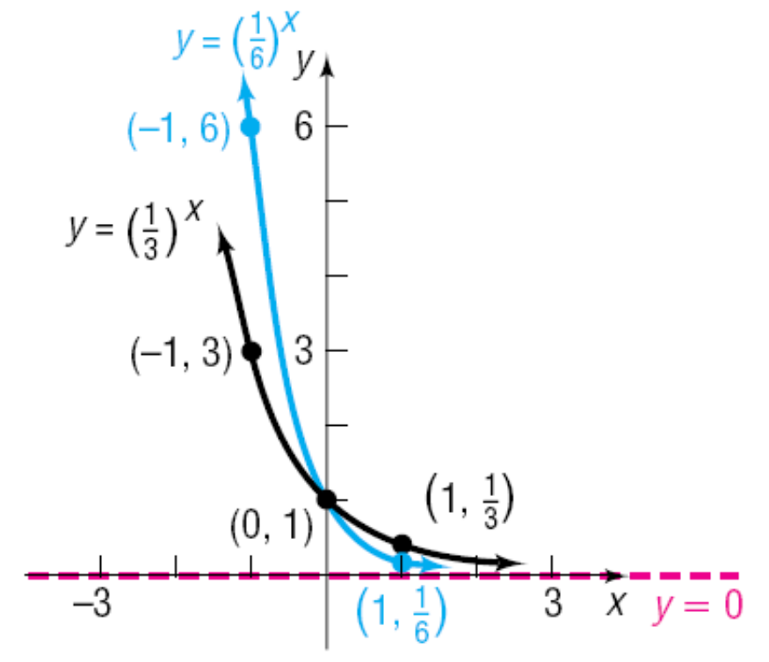
Copyright © 2012 Pearson Education, Inc. Publishing as Prentice Hall.

Slide 21
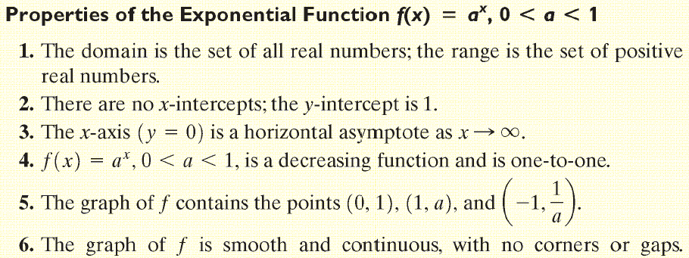
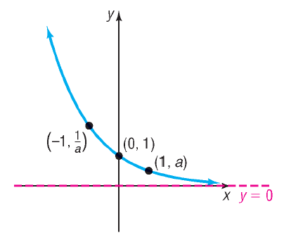

Copyright © 2012 Pearson Education, Inc. Publishing as Prentice Hall.

Slide 22


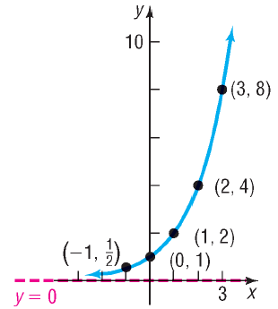
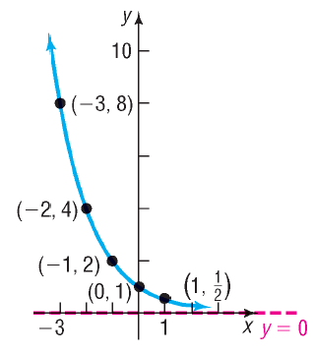
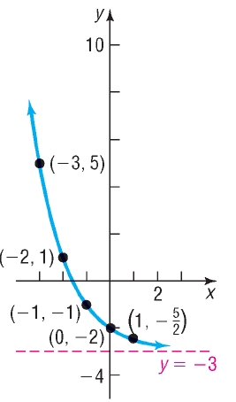

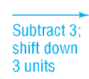
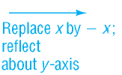


Copyright © 2012 Pearson Education, Inc. Publishing as Prentice Hall.

Slide 23

Copyright © 2012 Pearson Education, Inc. Publishing as Prentice Hall.

Slide 24

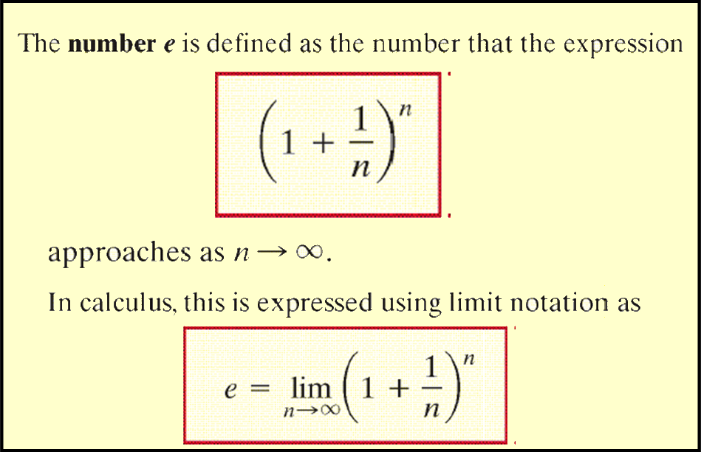
Copyright © 2012 Pearson Education, Inc. Publishing as Prentice Hall.

Slide 25
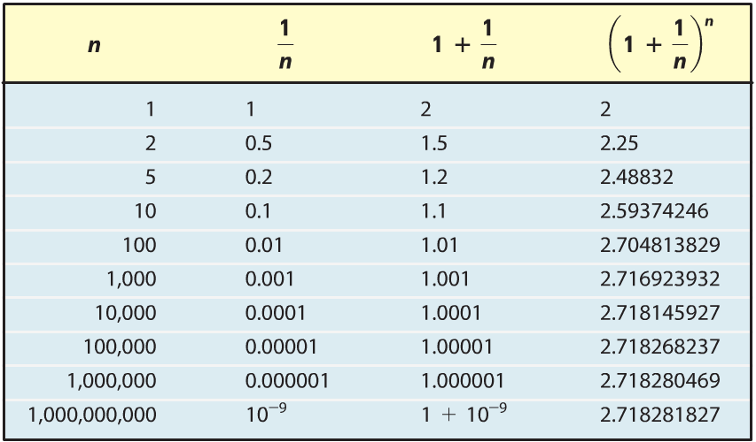
Copyright © 2012 Pearson Education, Inc. Publishing as Prentice Hall.

Slide 26
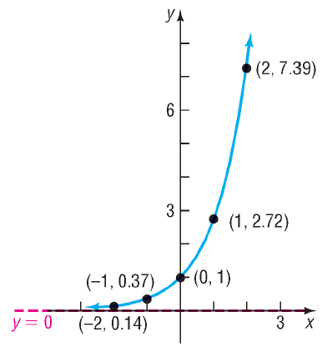
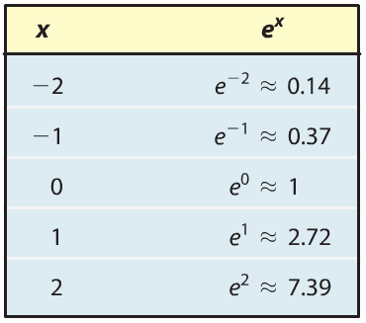
Copyright © 2012 Pearson Education, Inc. Publishing as Prentice Hall.

Slide 27

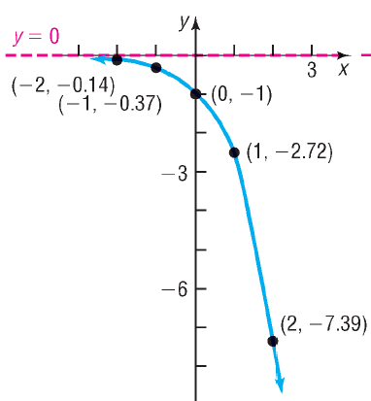
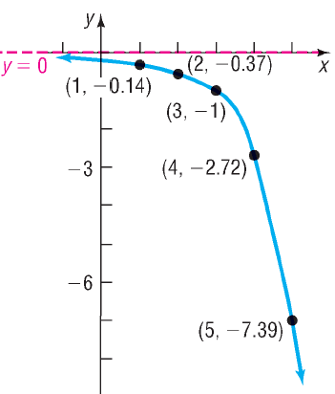
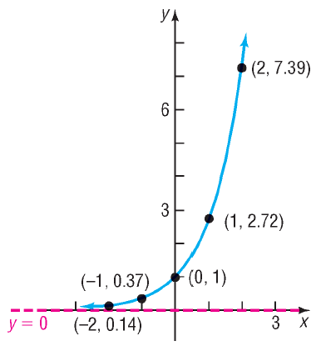

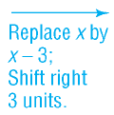


Copyright © 2012 Pearson Education, Inc. Publishing as Prentice Hall.

Slide 28

Copyright © 2012 Pearson Education, Inc. Publishing as Prentice Hall.

Slide 29

Copyright © 2012 Pearson Education, Inc. Publishing as Prentice Hall.

Slide 30
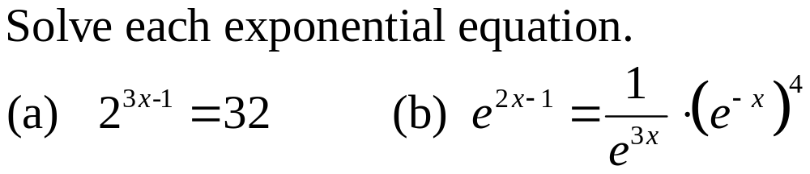
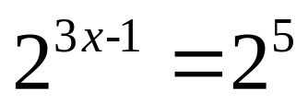
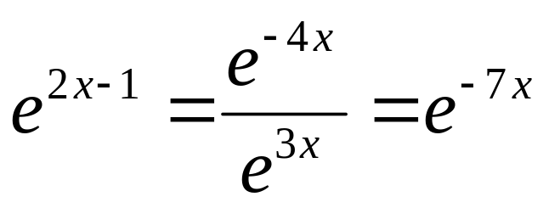
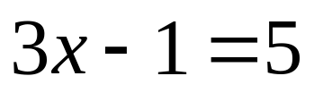
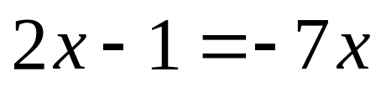


Copyright © 2012 Pearson Education, Inc. Publishing as Prentice Hall.

Slide 31



Copyright © 2012 Pearson Education, Inc. Publishing as Prentice Hall.

Slide 32

Copyright © 2012 Pearson Education, Inc. Publishing as Prentice Hall.

Slide 33


Figure 29
Copyright © 2012 Pearson Education, Inc. Publishing as Prentice Hall.

Slide 34



Copyright © 2012 Pearson Education, Inc. Publishing as Prentice Hall.

